Slide 1
Lecture 2 Investigating Relationships
Faculty of Computer Science
Data Analysis
Moscow 2022
Lecturer: Alisa Melikyan, amelikyan@hse.ru, PhD,
Associate Professor of the School of Software Engineering

Slide 2
Relationship between variables
Data Analysis
Lecture 2
Investigating Relationships
If we analyze the relationship between a pair of variables one of them is called independent (or explanatory) the other – dependent (or explainable). The quality of the variables relationship model could be estimated by the relation coefficients.
Depending on the task of the research, the variables scales and the data availability we should select an appropriate method for analyzing the relationship.

Slide 3
Contingency table
Data Analysis
Lecture 2
Investigating Relationships
Relationship between categorical variables (nominal or ordinal) could be represented by a contingency table.
The contingency tables could help to reveal the existence of statistical, but not causal relationship.
Together with the contingency tables different coefficients that evaluate the force of the variable relationship could be calculated.

Slide 4
Contingency table with frequencies
Data Analysis
Lecture 2
Investigating Relationships

Slide 5
Contingency table with frequencies and column percentages
Data Analysis
Lecture 2
Investigating Relationships

Slide 6
Contingency table with frequencies and row percentages
Data Analysis
Lecture 2
Investigating Relationships

Slide 7
Bar chart with frequencies in multiple groups
Data Analysis
Lecture 2
Investigating Relationships

Slide 8
Bar chart with percentages in multiple groups
Data Analysis
Lecture 2
Investigating Relationships

Slide 9
Inferential Statistics
Data Analysis
Lecture 2
Investigating Relationships
Inferential statistics – consists of generalizing from sample to populations, performing hypothesis testing, determining relationships among variables and making predictions. We use probability to determine whether it is likely that a particular test outcome is representative of the population.

Slide 10
Statistics
Data Analysis
Lecture 2
Investigating Relationships
Descriptive
Organizing and summing the data using numbers and graphs: bar and pie charts, histogram (skewness and kurtosis), frequency distribution table, central tendency statistics (mean, median, mode), measures of variability (range, variance, standard deviation).
Inferential
Using sample data to make an inference or draw a conclusion of the population.
Using probability to determine how confident we can be that the conclusions we make are correct.

Slide 11
Hypotheses Testing
Data Analysis
Lecture 2
Investigating Relationships
Hypothesis is a testable prediction about a real world phenomenon.
Experimental hypothesis proposes a starting point that will be accepted or rejected by examining the evidence that supports or contradicts it. If the evidence supports the hypothesis, we accept it, if not we reject it.

Slide 12
Experimental Hypotheses
Data Analysis
Lecture 2
Investigating Relationships
There are two Experimental Hypotheses:
Null Hypothesis (H₀)
Alternative Hypothesis (H₁ or H_{A})

Slide 13
Null Hypothesis
Data Analysis
Lecture 2
Investigating Relationships
Null Hypothesis: the means in two groups are the same, there is no relationship between variables, there is no difference between the distribution of the variable and normal distribution.
Any differences or relationships that we observe are due to chance.

Slide 14
Alternative Hypothesis
Data Analysis
Lecture 2
Investigating Relationships
Alternative Hypothesis: the means in two groups are not the same, there is a relationship between variables, there is a difference between the distribution of the variable and normal distribution.
Any differences or relationships are due to an effect.

Slide 15
Steps of statistical analysis
Data Analysis
Lecture 2
Investigating Relationships
Generate hypothesis (or hypotheses)
Collect some useful data to check the hypothesis.
Fit a statistical model to the data – this model will test the original prediction.
Assess this model to see whether it supports the initial predictions.

Slide 16
Testing hypotheses
Data Analysis
Lecture 2
Investigating Relationships
Research or Experimental hypothesis (H1) – prediction that your experimental manipulation will have some effect or that certain variables will relate to each other.
Null hypothesis (H0) – assumption that your prediction is wrong and that the predicted effect doesn’t exist.
Results of testing hypotheses:
H0 is rejected, H1 is accepted;
H0 is not rejected, H1 is rejected.

Slide 17
p-value
Data Analysis
Lecture 2
Investigating Relationships
P-value is a number between 0 and 1. It shows how confident we should be that our experimental hypothesis (H1) is true. The closer p-value is to 0, the more confidence we are that H1 is true. The question is how small does a p-value have to be before we are sufficiently confident that H1 is true, what threshold can we use to make a good decision?
A commonly used threshold is 0.05. It means that if we do the same analysis/experiments on a different samples than only 5% of those experiments would give an opposite result.

Slide 18
Level of significance
Data Analysis
Lecture 2
Investigating Relationships
If it’s extremely important that we are correct about the conclusions we make, then we can use a smaller threshold, like 0.00001. It means that we would be not correct only once every 100 000 experiments.
If it’s not that important to be correct, for example we are predicting if the bus will arrive on time, then we can use a larger threshold, like 0.2. It means that we would be not correct only 2 times out of 10.
The most common threshold is 0.05 because trying to reduce it often costs more than it worth.

Slide 19
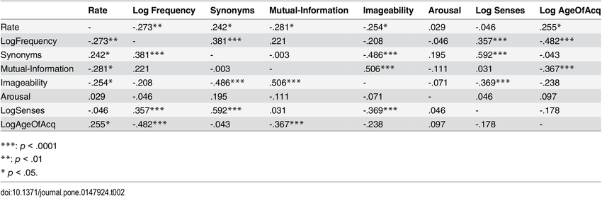

Data Analysis
Lecture 2
Investigating Relationships

Slide 20
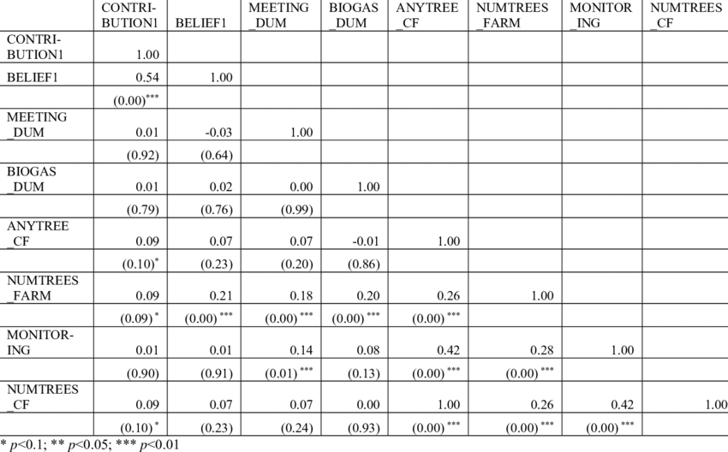
Data Analysis
Lecture 2
Investigating Relationships

Slide 21
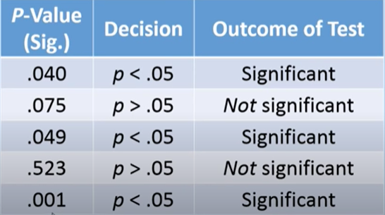
P-value: examples
Data Analysis
Lecture 2
Investigating Relationships
If the level of significance is 0.05

Slide 22
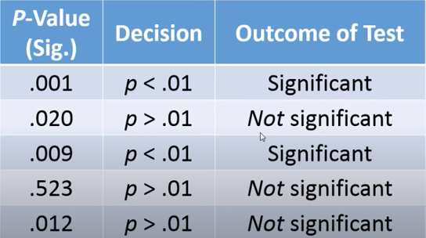
P-value: examples
Data Analysis
Lecture 2
Investigating Relationships
If the level of significance is 0.01

Slide 23
Hypothesis testing
Data Analysis
Lecture 2
Investigating Relationships
H1: there is a relationship between students’ attendance and performance
p-value = 0.0000001 → H1 is accepted at 1% level
p-value = 0.049 → H1 is accepted at 5% level
p-value = 0.051 → H1 is rejected at 5% level, but can be accepted at 10% level
p-value = 0.73 → H1 is rejected at 10% level

Slide 24
Hypothesis testing
Data Analysis
Lecture 2
Investigating Relationships
H1: there is a relationship between students’ attendance and performance
p-value = 0.0000001 → H1 is accepted at 1% level
p-value = 0.049 → H1 is accepted at 5% level
p-value = 0.051 → H1 is rejected at 5% level, but can be accepted at 10% level
p-value = 0.73 → H1 is rejected at 10% level

Slide 25
Note about p-value
Data Analysis
Lecture 2
Investigating Relationships
H1: mean grades of boys and girls are not the same
H2: there is a relationship between students’ attendance and performance
H3: there is a difference between the distribution of students’ grades and normal distribution.
A small p-value is an indicator that we should accept these hypotheses, but it doesn’t tell us how different are the grades of the boys and girls, how strong is the relationship between attendance and performance etc. So, you can have the same p-value in case of low and in case of high difference between grades of boys and girls.

Slide 26
Type I and Type II errors
МАГОЛЕГО «Анализ данных»
Лекция 2
Исследование взаимосвязей
 | H₀ is true | H₀ is false
H₀ is not rejected | H₀ is not rejected correctly | Type 2 error
H₀ is rejected | Type 1 error | H₀ is rejected correctly
Type 1 error occurs when we believe that there is a genuine effect in our population, when in fact there isn’t. The probability of this error is the level of significance (0,05).
Type 2 error occurs when we believe that there is no effect in the population when, in reality, there is.

Slide 27
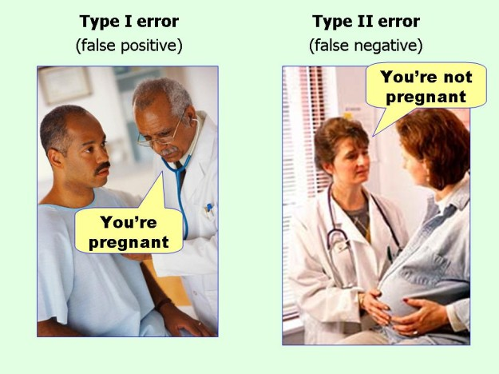
Type I and Type II errors
МАГОЛЕГО «Анализ данных»
Лекция 2
Исследование взаимосвязей

Slide 28
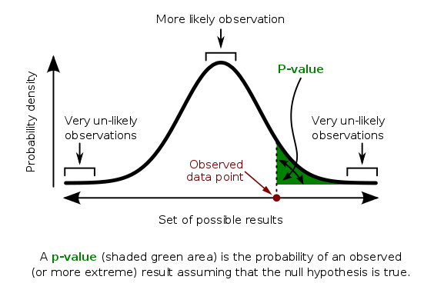
МАГОЛЕГО «Анализ данных»
Лекция 2
Исследование взаимосвязей

Slide 29
Select an appropriate test to analyze the relationship between variables
Data Analysis
Lecture 2
Investigating Relationships
Step 1: purpose of the research
To select an appropriate test you should specify the purpose of your research. There are two possible major purposes: comparison or relationship.
Comparison tries to understand whether there is a difference between the groups. For example, grades of boys vs grades of girls, results of control group vs results of treatment group, the distribution of salary vs normal distribution. We can compare the variables’ values in 2 or more groups.
Relationship tries to find a connection, for example, relation between age an salary, advertising budget and income.

Slide 30
Select an appropriate test to analyze the relationship between variables
Data Analysis
Lecture 2
Investigating Relationships
Step 2: type of data
We should consider the type of the data we are looking at. We could have categorical (qualitative characteristics) or continuous (quantitative or numerical) data.
Once you have defined the purpose of the research and the type of the data you have you can select from 3 main families of statistical tests:
Chi-Squared
Correlation
t-test/ANOVA

Slide 31
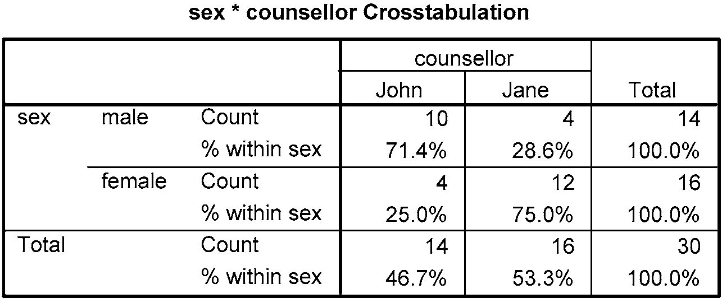
Chi-squared statistical test
Data Analysis
Lecture 2
Investigating Relationships
Chi-squared statistical test is used to examine associations between variables. Most frequently it’s used with categorical variables. Let’s look at the contingency table between sex of the patient and the counsellors (Jane and John).

Slide 32
Chi-squared statistical test
Data Analysis
Lecture 2
Investigating Relationships
We can see that the sex of patients is not equally distributed across the counsellors. We might ask was this a chance result? If we started the service again and the patients were randomly assigned to the counsellors might we have found a similar result? Perhaps even the opposite – with most male patients seeing the female counsellor. More likely of course, by chance, we would expect them to be distributed quite evenly across the sexes.
The question is: how much of an unequal distribution across the sexes does there have to be for us to conclude that there was a significant bias for male patients to see a male counsellor and vice versa? Or, to put it another way: how much of an unequal distribution across the sexes does there have to be for us to reject the possibility that this has occurred by chance? This is where a statistical test comes in handy.

Slide 33
Chi-squared statistical test
Data Analysis
Lecture 2
Investigating Relationships
Chi-squared applies a statistical test to cross-tabulation by comparing the actual observed frequencies in each cell of table with expected frequencies. Expected frequencies are those we would expect if data is ‘randomly distributed’.
Two variables are mutually independent, if an observed frequency in each cell is equal to an expected frequency.

Slide 34
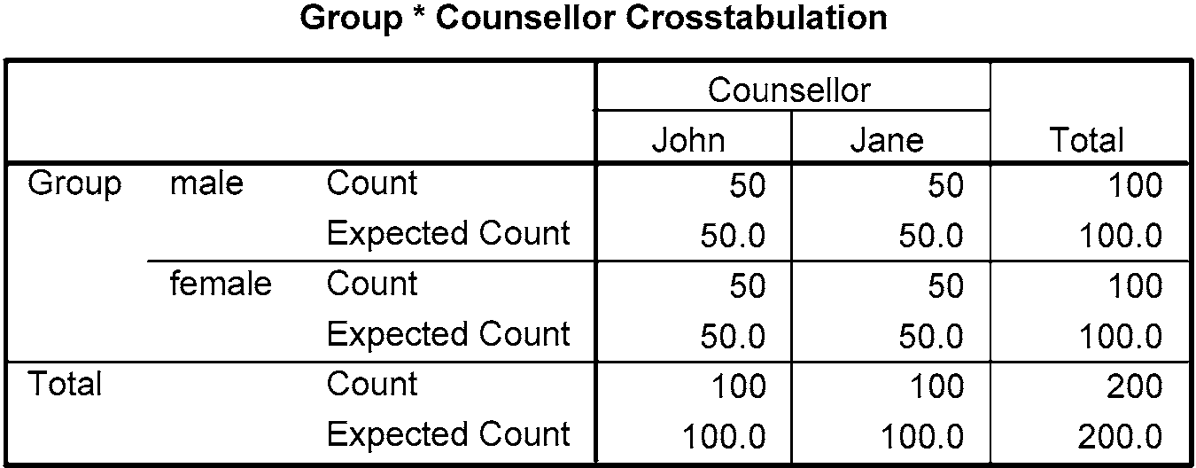
Scenario 1
Data Analysis
Lecture 2
Investigating Relationships
There is no difference across male/female patients and counsellor. The actual observed counts match the expected counts.

Slide 35
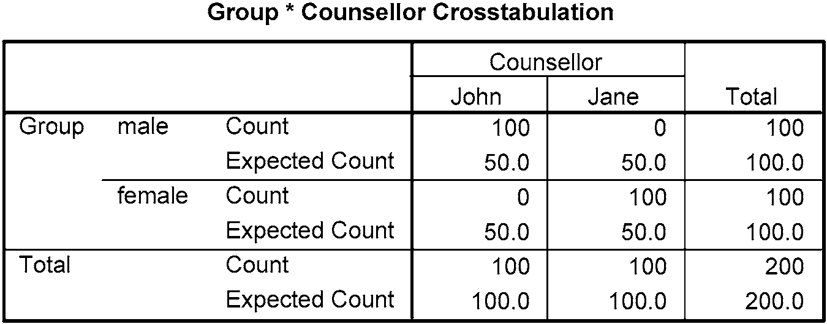
Scenario 2
Data Analysis
Lecture 2
Investigating Relationships
All the males saw John, whereas all the females saw Jane. Notice that the expected frequencies remain the same – 50 in each cell. The divergence from expected frequencies would strongly suggest that there is a relationship between sex of the patient and the counsellor they saw.

Slide 36
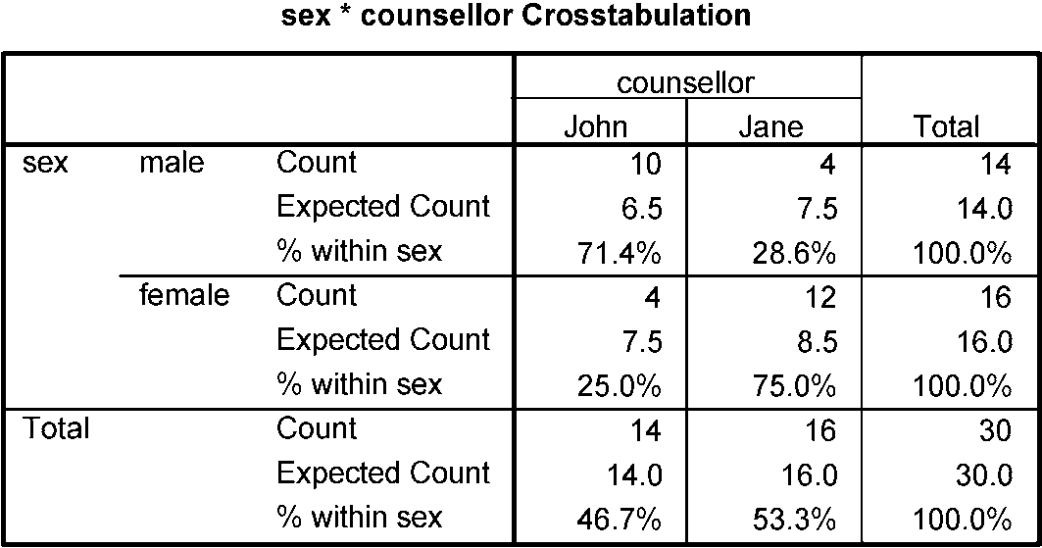
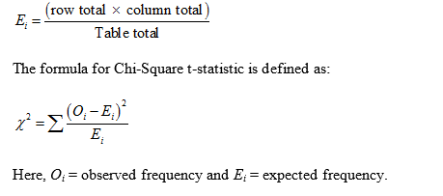

Scenario 3
Data Analysis
Lecture 2
Investigating Relationships
$$7.5= \frac{14∗16}{30}$$

Slide 37
Calculating Chi-squared
Data Analysis
Lecture 2
Investigating Relationships

Slide 38
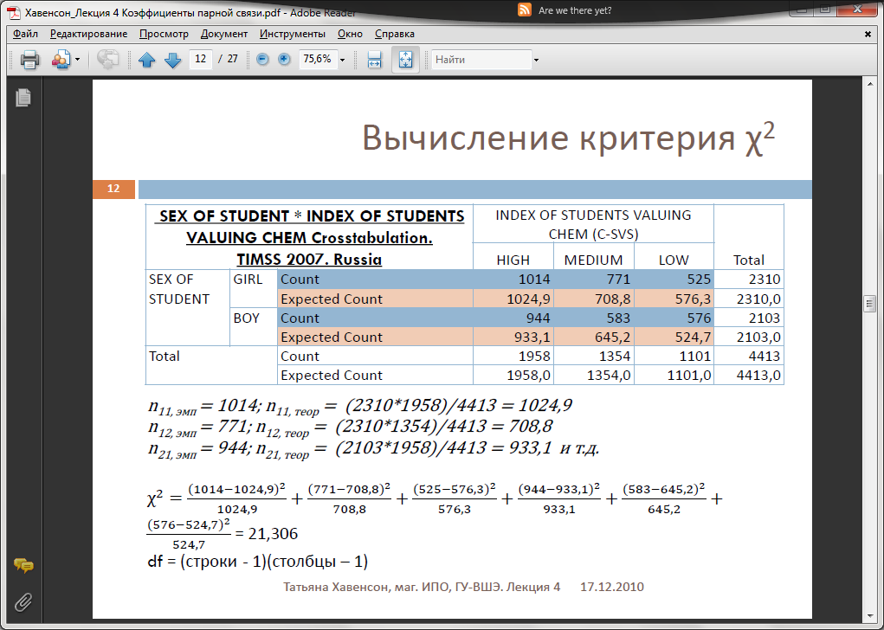
Example
Data Analysis
Lecture 2
Investigating Relationships
df = (rows -1) * (columns – 1) = (2-1)*(3-1) = 2

Slide 39
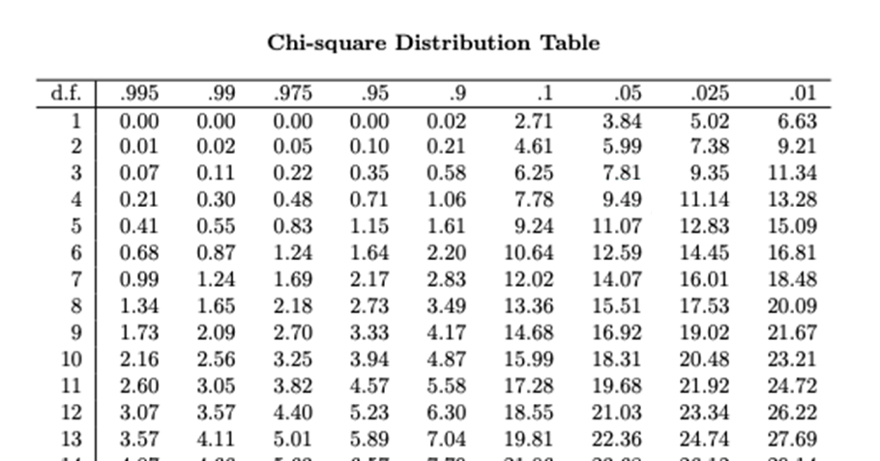
Data Analysis
Lecture 2
Investigating Relationships
Chi-squared calculator: https://www.di-mgt.com.au/chisquare-calculator.html

Slide 40
Conclusions
Data Analysis
Lecture 2
Investigating Relationships
Ho: There is no relationship between the sex and the grades in chemistry.
H1: There is a relationship between the sex and the grades in chemistry.
In the table of Chi-squared statistical distribution we can find that the critical value for df = (2-1)*(3-1) = 2 and significance level p=0,05 is 5,99. So if there is no relation between the variables the Chi-squared statistics should be not grater than 5,99. In our case 21,3>5,99 so we should reject Ho and accept H1 – there is a relationship between variables.

Slide 41
Properties of Chi-squared
Data Analysis
Lecture 2
Investigating Relationships
Interval of values ​​from 0 to + ∞.
The value doesn't permit to know which variable is dependent and which is independent.
Doesn’t evaluate the force of the relationship. The bigger the sample – the bigger the value of chi-squared.
The conventional rule of thumb is that if all (more than 95%) of the expected counts in the contingency table are greater than 5, it's acceptable to use the chi-squared test.

Slide 42
Testing the normality of the distribution
Data Analysis
Lecture 2
Investigating Relationships
We can look at the histogram, but in order to receive an objective information weather our distribution is different from “normal” or not we have to run a statistical test.
The Kolmogorov-Smirnov and Shapiro-Wilks tests permit to test whether the distribution as a whole deviates from a comparable normal distribution. These tests compare the scores in the sample to a normally distributed set of scores with same mean and standard deviation. Shapiro-Wilks is calculated if the sample size is less than 50.

Slide 43
Normality test
Data Analysis
Lecture 2
Investigating Relationships
Hypothesis 0: The values are sampled from normally-distributed population.
Hypothesis 1: The values are not sampled from normally-distributed population.
If the significance of the test is > 0,05 we reject H1 and conclude that our distribution is not significantly different from the normal distribution.
If the significance of the test is <= 0,05 we reject H0, accept H1 and conclude that our distribution is significantly different from the normal distribution.

Slide 44
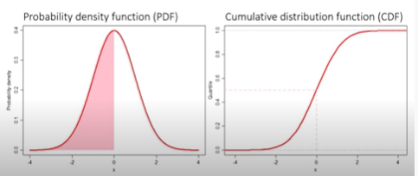
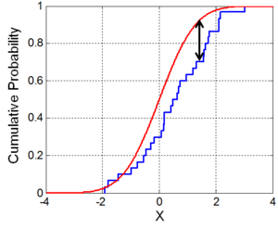
Kolmogorov-Smirnov normality test
Data Analysis
Lecture 2
Investigating Relationships
The idea behind the Kolmogorov-Smirnov test is that the maximum difference between the assumed cumulative normal distribution function and the sample to be investigated is used to decide whether the random sample belongs to the distribution or not.
D statistic
The bigger the D statistic, the higher is the difference between variable’s distribution and normal distribution.

Slide 45
Shapiro-Wilk normality test
Data Analysis
Lecture 2
Investigating Relationships
The basis idea is to estimate the variance of the sample. The values should approximately equal in the case of a normal distribution and thus should result in a quotient of close to 1.0. If the quotient is significantly lower than 1.0 then the null hypothesis (of having a normal distribution) should be rejected.
Details here: http://www.statistics4u.info/fundstat_eng/ee_shapiro_wilk_test.html

Slide 46
Correlation Analysis: stages
Data Analysis
Lecture 2
Investigating Relationships
Create a scatterplot to check that there is a linear relationship between the variables and find out possible outliers;
Select appropriate correlation coefficient depending on the specific characteristics of the variables;
Calculate correlation coefficient and the corresponding p-value;
Interpret the significance, strength and direction of the relationship.

Slide 47
Scatterplot
Data Analysis
Lecture 2
Investigating Relationships
Before conducting any correlational analysis it’s essential to plot a scatterplot to look at the general trend of the data. A scatterplot is simply a graph that plots each persons score on one variable against their score on another and tells whether there seems to be a relationship between variables, what kind of relationship it is and whether any cases are markedly different from the others (outliers). The outliers could severely bias the correlation coefficient.

Slide 48
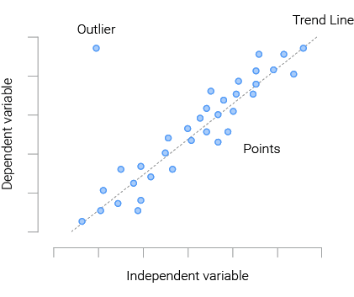
Scatterplot
Data Analysis
Lecture 2
Investigating Relationships

Slide 49
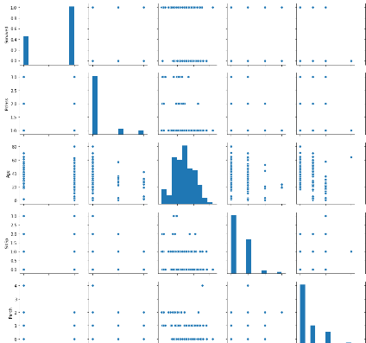
Scatterplot Matrix
Data Analysis
Lecture 2
Investigating Relationships

Slide 50
Correlation
Data Analysis
Lecture 2
Investigating Relationships
Correlation describes the direction and strength of a relationship between two variables (e.g., height and shoe size). The direction can be positive or negative.
Positive correlation: an increase in values for one variable is associated with an increase in values for the other variable, for example, as height increases so does shoe size.
Negative correlation: an increase in values for one variable is associated with a decrease in values on another variable, for example, as temperature reduces the use of electricity for heating increases.

Slide 51
Correlation coefficients
Data Analysis
Lecture 2
Investigating Relationships
1. Pearson correlation coefficient,
2. Spearman rank correlation coefficient,
3. Kendall rank correlation coefficient.

Slide 52
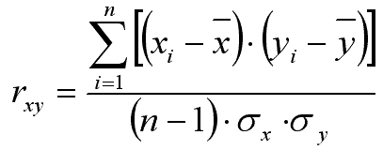
Pearson correlation coefficient
Data Analysis
Lecture 2
Investigating Relationships
Evaluates the force of linear relation between two variables.
The value of the coefficient lies between -1 and +1.
Could be calculated only for interval “normal” variables
Measures the direction (positive vs. negative) and strength (value) of the relationship.

Slide 53
Interpretation of Pearson correlation coefficient’s values
Data Analysis
Lecture 2
Investigating Relationships
A coefficient of +1 indicates that the two variables are perfectly positively correlated, so as one variable increases the other increases by a proportionate amount.
Conversely, a coefficient of -1 indicates a perfect negative relationship: if one variable increases the other decreases by a proportionate amount.
A coefficient of 0 indicates no linear relationship at all.

Slide 54
Interpretation of Pearson correlation coefficient’s values
Data Analysis
Lecture 2
Investigating Relationships
Value of Pearson’s correlation coefficient | Interpretation
0 < r <= 0,2 | Very weak correlation
0,2 < r <= 0,5 | Weak correlation
0,5 < r <= 0,7 | Medium correlation
0,7 < r <= 0,9 | Strong correlation
0,9 < r <= 1 | Very strong correlation

Slide 55
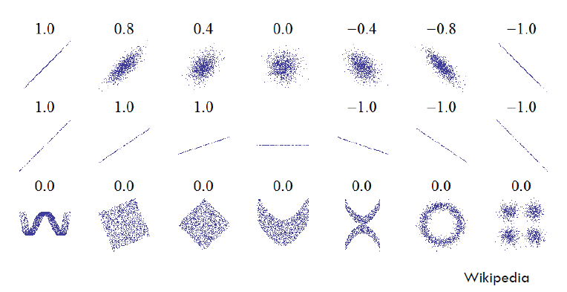
Scatterplot for different values of r
Data Analysis
Lecture 2
Investigating Relationships

Slide 56
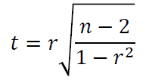
Significance of Pearson correlation coefficient
Data Analysis
Lecture 2
Investigating Relationships
H₀: r = 0, H₁: r != 0
Calculate t-criterion
According to the table of Student's distribution determine the critical t-value for a given level of significance and degrees of freedom.
If the actual value (calculated in step 2) exceeds the critical value (calculated in step 3), then the hypothesis H₀ is rejected and H₁is accepted.
Python calculates p-value which should be compared with the significance level selected by researcher (0,05 or 0,01).

Slide 57
Interpretation: causality
Data Analysis
Lecture 2
Investigating Relationships
The correlation coefficients give no indication of the direction of causality. So, for example, even if we can conclude that exam performance goes down as anxiety about that exam goes up, we cannot say the high exam anxiety causes bad exam performance. This caution is for two reasons:
the third-variable problem;
direction of causality.

Slide 58
Using R2 for interpretation
Data Analysis
Lecture 2
Investigating Relationships
R² – coefficient of determination is calculated as squared correlation coefficient. It’s a measure of the amount of variability in one variable that is explained by the other.

Slide 59
Rank correlation coefficients
Data Analysis
Lecture 2
Investigating Relationships
Are used to evaluate the relationship between ordinal variables or internal variables that are not normally distributed.
To calculate the coefficient the ranks of the values are used.
There are two most popular rank correlation coefficients: Spearmen’s and Kendall’s.
Kendall’s coefficient should be selected if we have many tied ranks. If the majority of values are unique we select Spearmen’s coefficient.

Slide 60

Spearman’s rho correlation coefficient
Data Analysis
Lecture 2
Investigating Relationships
Could be calculated for non-normally distributed variables, ordinal variables or where the relationship is not linear. First the scores should be ranked. Is appropriate where you have no more than one or two tied ranks.

Slide 61
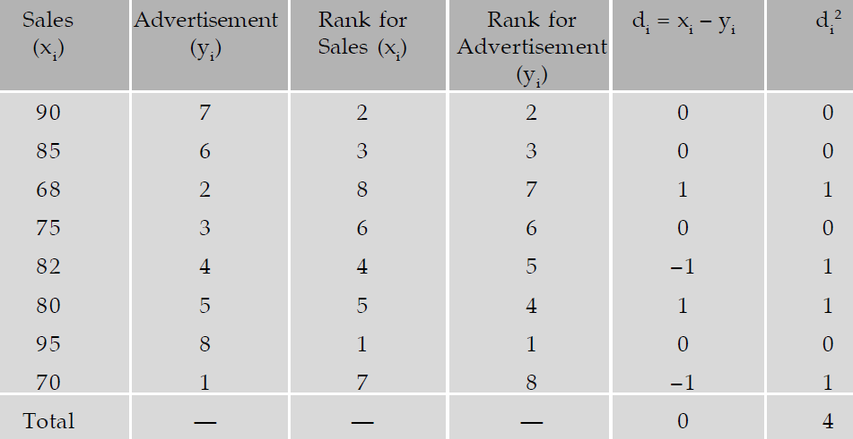
Spearman’s correlation coefficient
Data Analysis
Lecture 2
Investigating Relationships

Slide 62
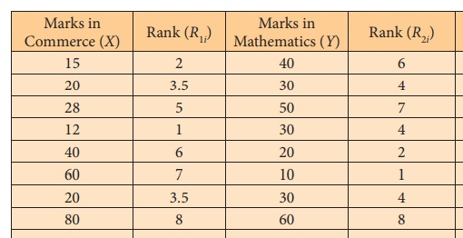
Tied ranks
Data Analysis
Lecture 2
Investigating Relationships

Slide 63
Kendall’s tau correlation coefficient
Data Analysis
Lecture 2
Investigating Relationships
Kendall’s tau is another non-parametric correlation and it should be used when you have a small data set with a large number of tied ranks. This means that if you rank all of the scores and many scores have the same rank, Kendall’s tau should be used. It represents the degree of concordance between two columns of ranked data.

Slide 64
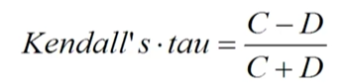
Kendall’s tau
Data Analysis
Lecture 2
Investigating Relationships
C – number of concordant pairs
D – number of discordant pairs

Slide 65
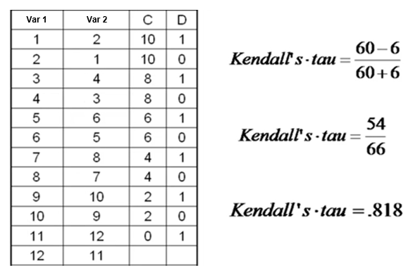
Kendall’s tau
Data Analysis
Lecture 2
Investigating Relationships

Slide 66
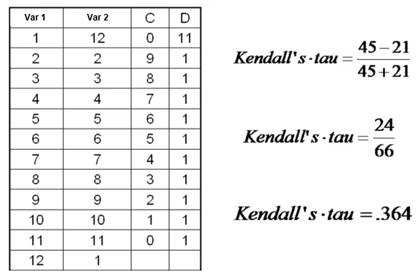
Kendall’s tau
Data Analysis
Lecture 2
Investigating Relationships

Slide 67
Comparing correlation coefficients
Data Analysis
Lecture 2
Investigating Relationships
Correlation coefficient | Variables
Pearson’s correlation coefficient | Both variables are interval and normally distributed
Spearman's rank correlation coefficient | Both variables are interval, most of their values are unique, but they are not normally distributed
Kendall’s rank correlation coefficient | Variables are interval or ordinal, values are not unique (there are many tied ranks)

Slide 68
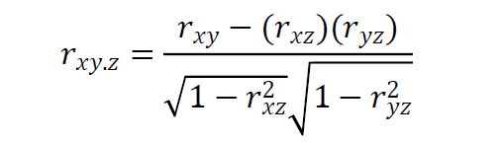
Partial correlation
Data Analysis
Lecture 2
Investigating Relationships
Partial correlation looks at the relationship between two variables while “controlling” the effect of one or more additional variables.
Partial correlations are used to find out the size of the unique portion of variance.
H0: there is no relationship between two variables after controlling for effects of confounding variable

Slide 69
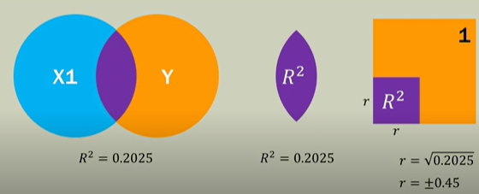
Partial correlation
Data Analysis
Lecture 2
Investigating Relationships
R² is an area of overlap. The area of each circle is 1.

Slide 70
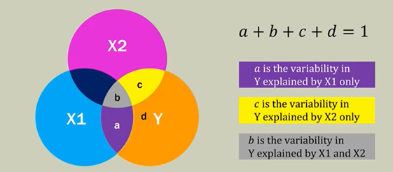
Partial correlation
Data Analysis
Lecture 2
Investigating Relationships

Slide 71
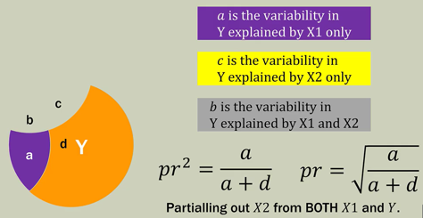
Partial correlation
Data Analysis
Lecture 2
Investigating Relationships
Source: https://www.youtube.com/watch?v=UyyWsctkXaw

Slide 72
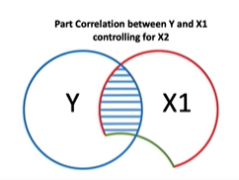
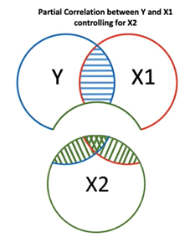
Part (semi-partial) and partial correlation
Data Analysis
Lecture 2
Investigating Relationships
The effect of X2 on Y has not been removed

Slide 73
Semi-partial (or part) correlation
Data Analysis
Lecture 2
Investigating Relationships
When we do a partial correlation we control for the effect that the third variable has on both variables in the correlation. In a semi-partial correlation we control for the effect that the third variable has on only one of the variables in the correlation.

Slide 74

Semi-partial (or part) correlation
Data Analysis
Lecture 2
Investigating Relationships
Correlation between 1 and 2 controlling the effect of 3 on 2.
Correlation between 1 and 2 controlling the effect of 3 on 1.

Slide 75
Example of a partial correlation
Data Analysis
Lecture 2
Investigating Relationships
Paul Broca in 1873 have found a strong relationship between gender and brain size: women’s brains are, on the whole, smaller than men’s. This was at the time used as evidence to argue that women were intellectually inferior to men. The obvious problem is that this relationship takes no account of body size: people with bigger bodies have bigger brains irrespective of intellectual ability.
Stephen Jay Gould in 1981 famously reanalyzed Broca’s data and demonstrated that the strong relationship between gender and brain size disappeared when you accounted for body size.

Slide 76
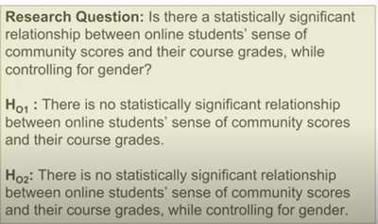
Example of a partial correlation
Data Analysis
Lecture 2
Investigating Relationships

Slide 77
Thank you for your attention!
Faculty of Computer Science
Data Analysis
Moscow 2022

